Slide 1
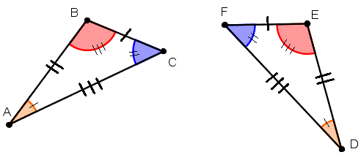
My Geometry Interactive Notebook
Name:
Class: 9-5
Teacher: Miss L
Term 2 Semester 1

Slide 2
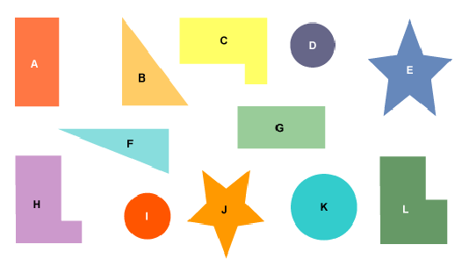
Congruence
Which shapes are the same?
Can you pair them up?

Slide 3
24
7
30
Topic: Congruent Triangles
Date
EQ - How do we know if two triangles are congruent?
Congruent shapes have the same shape and size. They can fit exactly on top of each other.
If something is flipped, rotated or translated (slide) then it is still congruent.
If something is enlarged, shrunk or stretched it is no longer congruent.
What is Congruent Shapes?

Slide 4
For example:
✓
✓
✓
✗
✗
✗

Slide 5
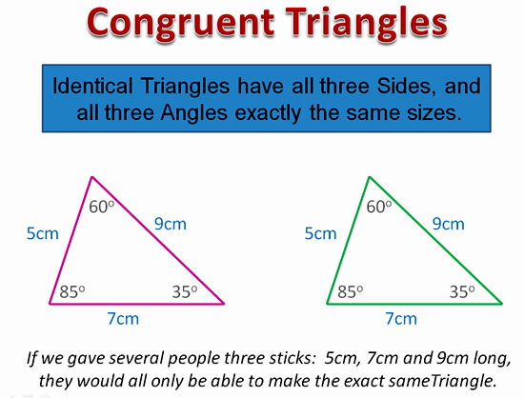
So what is the point? Why do we care about congruent triangles?

Slide 6
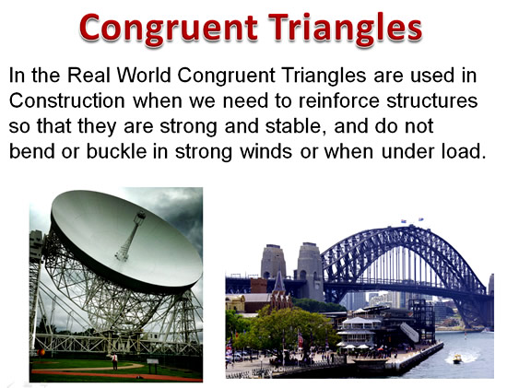

Slide 7
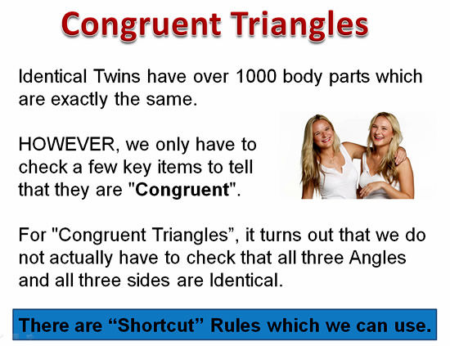

Slide 8
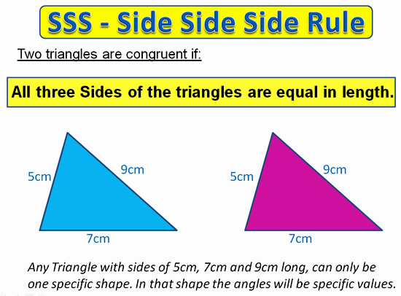
24
7
30
Topic: Congruent Triangles
Date
EQ - How do we know if two triangles are congruent?
SSS Rule

Slide 9
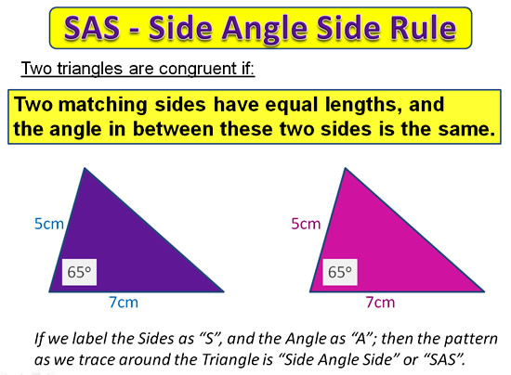
24
7
30
Topic: Congruent Triangles
Date
EQ - How do we know if two triangles are congruent?
SAS Rule

Slide 10
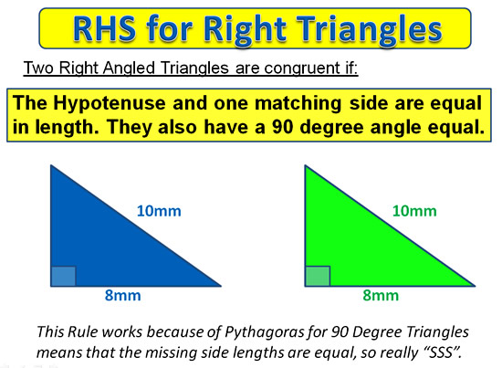
24
7
30
Topic: Congruent Triangles
Date
EQ - How do we know if two triangles are congruent?
RHS Rule

Slide 11
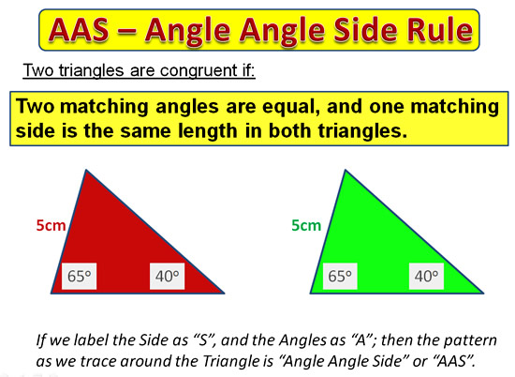
24
7
30
Topic: Congruent Triangles
Date
EQ - How do we know if two triangles are congruent?
AAS Rule

Slide 12
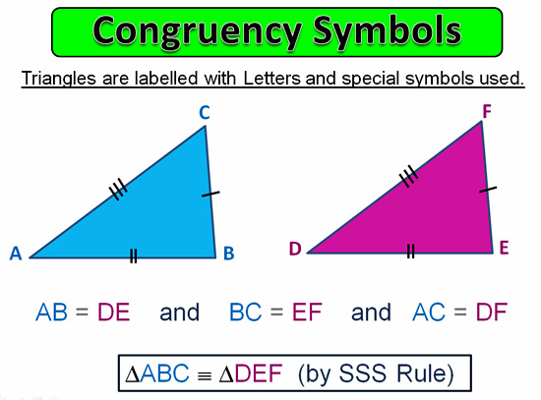

Slide 13
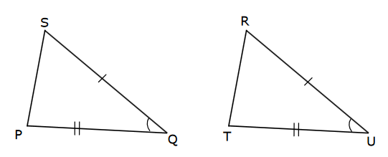
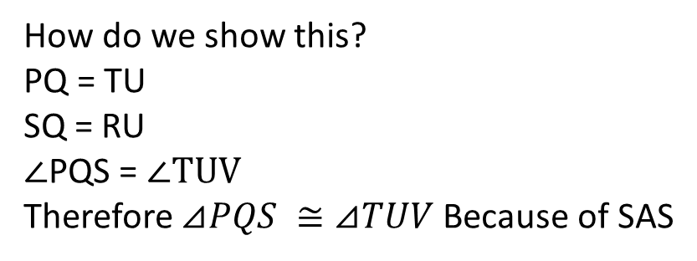
Time to try some.
Can we prove these triangles are congruent?
Yes
Why?
Because of the SAS rule
How do we show this?
PQ = TU
SQ = RU
$∠$PQS = $∠TUV$
Therefore $⊿PQS ≅⊿TUV$ Because of SAS

Slide 14
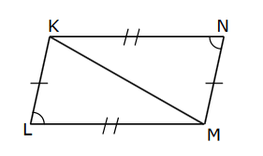
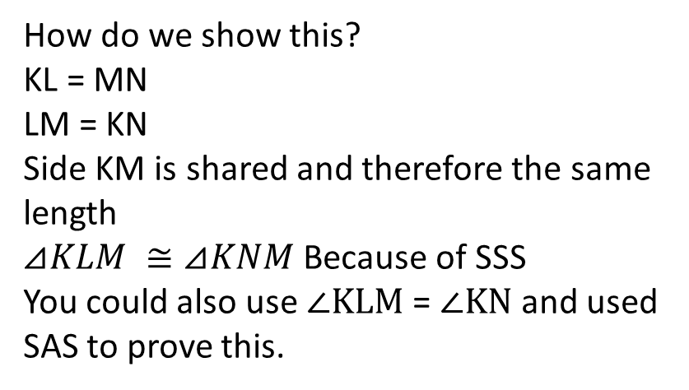
Time to try some.
Can we prove these triangles are congruent?
Yes
Why?
Because of either the SAS rule or SSS rule
How do we show this?
KL = MN
LM = KN
Side KM is shared and therefore the same length
$⊿KLM ≅⊿KNM$ Because of SSS
You could also use $∠KLM$ = $∠KN$ and used SAS to prove this.

Slide 15
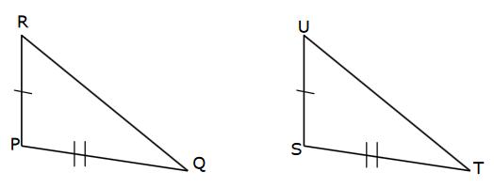
Can we prove these triangles are congruent?
No
Why?
We only know 2 sides are the same – we need 1 more side or the angle between them to PROVE congruency

